Slide 1
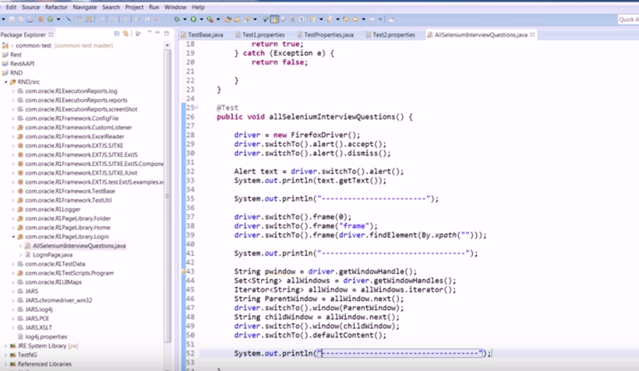
Notes:
To get to the current window we can give – driver.switchTo().defaultContent

Slide 2
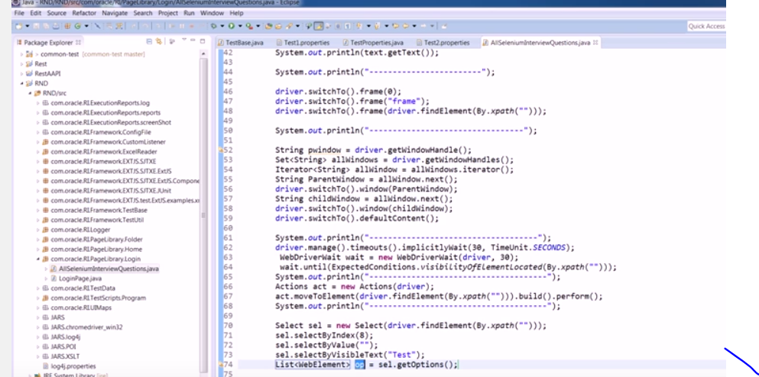
Notes:
To get all the data in drop down - driver.getOptions()

Slide 3
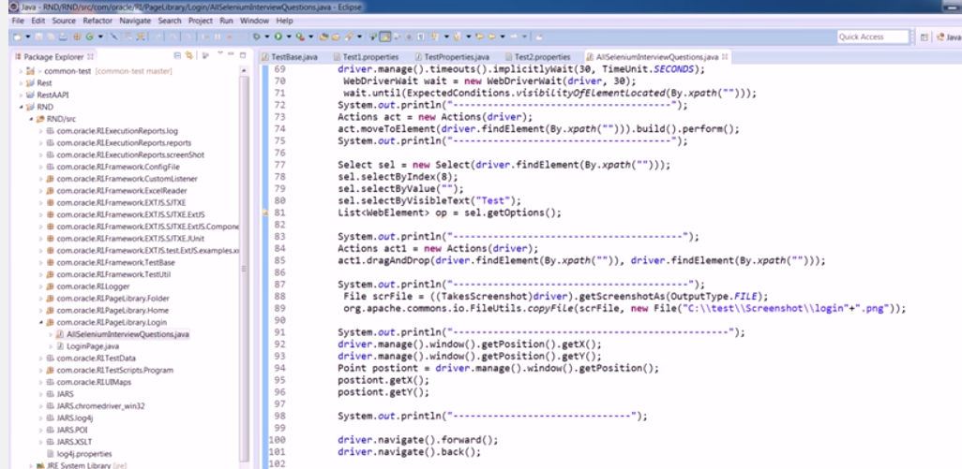
Notes:
1. To get the coordinates – driver.mange().window().getPosition().getX();
driver.mange().window().getPosition().getY();
2. Navigate
Driver.navigate.forward()
Driver.navigate.back()

Slide 4
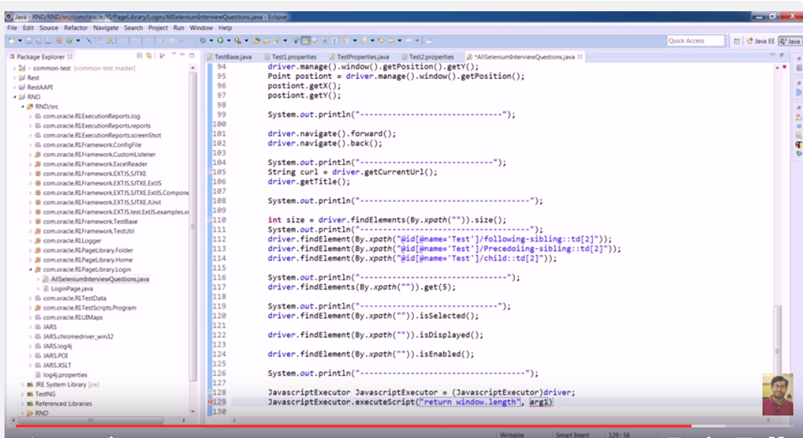
Notes:
Counting similar object present in the ui – driver.findElementsBy.xpath().size();
Syntax of following

